Slide 1


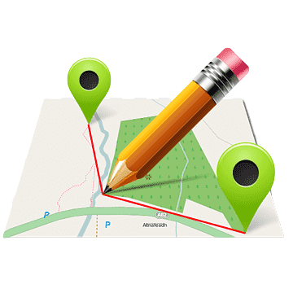

GROUP 5 - EARLY BIRDS
BIRDROADPATH

Slide 2




TEAM MEMBERS
Kevin Kyle R. Villavicencio
4th Year
BS Computer Engineering
System Administration
Rejay Mar V. Senar
4th Year
BS Computer Engineering
System Administration
Willord plotena
5th Year
BS Computer Engineering
Railway Engineering

Slide 3




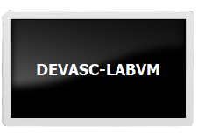
APPLICATION USED
MAPQUEST
VIRTUALBOX
VISUAL STUDIO CODE
GITHUB
DEVASC

Slide 4


ADDED FEATURES
It can give the longitude of the desired location
ABOUT OUR APPLICATION:
This application can give the distance, direction and the how many fuel will be needed in going to the destination of the user. We also added the geographical coordinate of the destination.
It can give the latitude of the desired location
Can give the right direction to any location international and local .

Slide 5
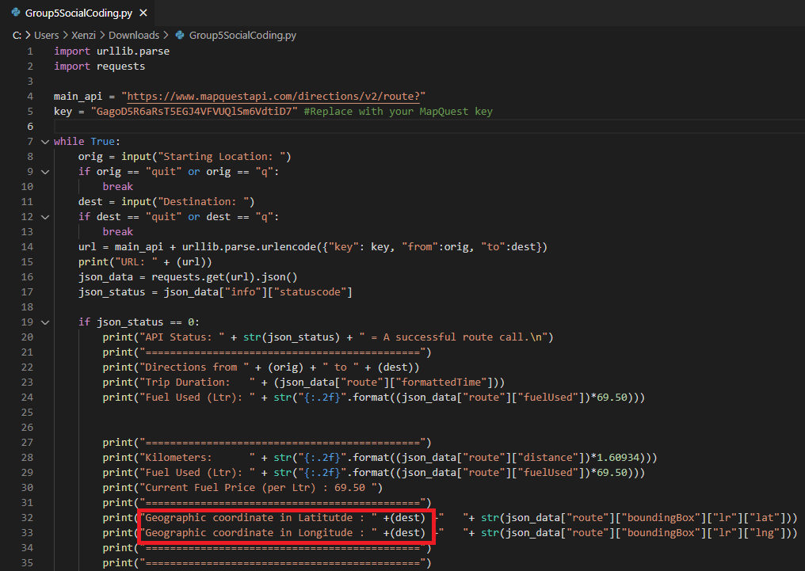
CODE:

Slide 6
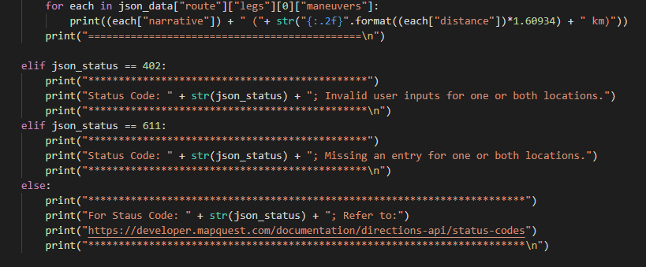
The first elif statement prints if the statuscode value is 402 for an invalid location.
The second elif statement prints if the statuscode value is 611 because the user did not provide an entry for one or both
locations.

Slide 7
MAP QUEST: URL FOR ROUTES
THIS FUNCTION BUILDS THE PARAMETERS PART OF THE URL AND CONVERTS POSSIBLE SPECIAL CHARACTERS IN THE ADDRESS VALUE INTO ACCEPTABLE CHARACTERS

Slide 8
The Result

Slide 9
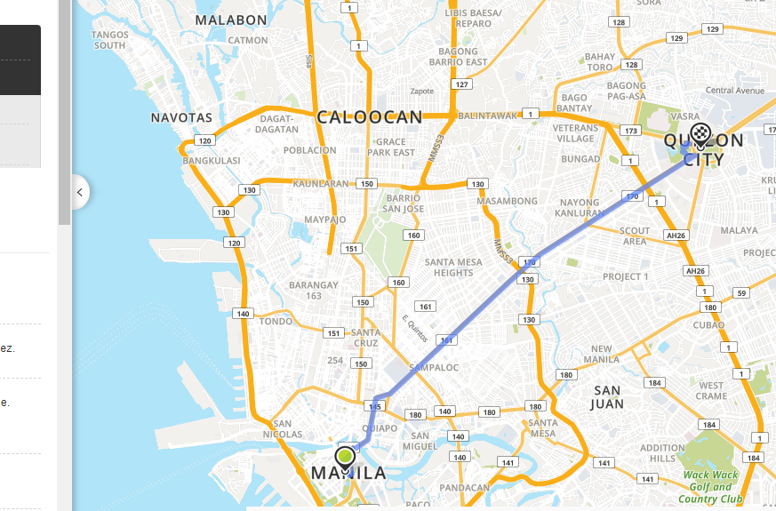
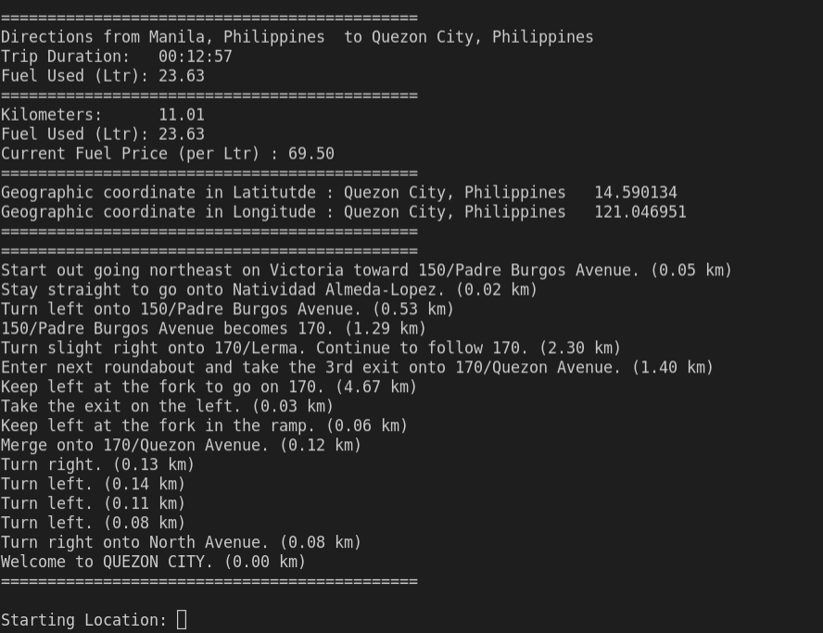
MANILA - QUEZON CITY

Slide 10
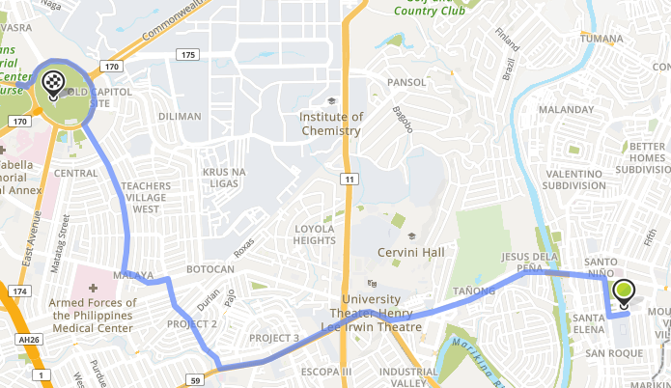
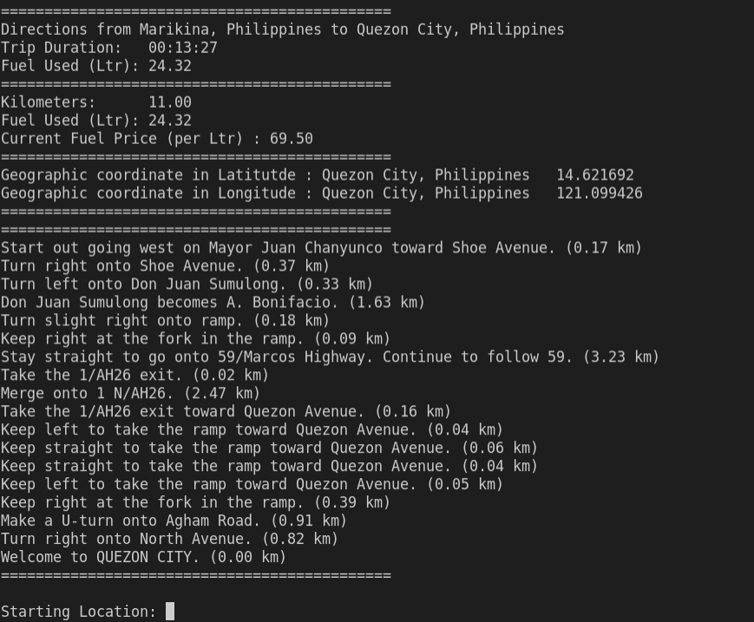
MARIKINA - QUEZON CITY

Slide 11

REFERENCES
https://www.mapquest.com/
https://developer.mapquest.com/
Hands-on Activity 7.1 Integrate a REST API in a Python Application.pdf

